Slide 1

ArthoAid-Smart Arthritis Detection System using AI
Dept. of Computer Application
Kalyani Government Engineering College
Maulana Abul Kalam Azad University of Technology
Presented by:
Souvik Dey [10271023035]
Sudip Patra [10271023038]
Aditya Mallick [10271023002]
Under the guidance of
Dr. Indrajit Bhattacharya
Assistant Professor,
Dept. of CA, KGEC

Slide 2
Index
Objectives
Motivation
Innovation
Work-flow
Current Status
Future Plan
Limitation
Conclusion

Slide 3
Objectives
Patient Classification :
Use Machine Learning to classify individuals as Healthy, RA, or OA patients.
OA Severity Grading :
Apply Deep Learning (CNN) to assess the severity of Osteoarthritis from knee X-rays.
Accessible Healthcare Tool :
Develop a low-cost, user-friendly support tool for arthritis that helps reduce misdiagnosis and improve patient care.

Slide 4
Motivation
Global Impact
Need for Early Detection
Arthritis affects millions of
people worldwide.
Early diagnosis prevents joint damage
and disability.
Role of AI
Practical Approach
Combination of Machine Learning
and Deep Learning can build smart,
accessible diagnostic tools.
X-rays are affordable and widely used,
making them ideal for severity prediction.

Slide 5
Innovation
Dual-model pipeline:
Structured data ML model for initial classification (Healthy/RA/OA).
CNN-based model for predicting OA severity from X-rays.
High accuracy in classification (up to 94.5%) using Random Forest.
Integration of medical image preprocessing and deep learning for severity grading.

Slide 6
Work-flow
Login / Registration- Go to Dashboard
Machine Learning model for initial classification – Rheumatoid Arthritis/Osteoarthritis/Healthy
If OA, go to another page and upload X-ray for severity prediction
CNN-based model for predicting OA severity from X-rays
System displays results and suggest for exercises or doctor recommendation

Slide 7
Current Status
.
Completed:
Clinical data collection and preprocessing.
Model 1 (ML-based classification using RF, XGBoost, Logistic Regression).
Achieved highest accuracy: 94.5% with Random Forest
In Progress:
Building CNN model for X-ray analysis.
Frontend and backend development for user interface and prediction display.
Nearby doctor recommendations on RA or OA severity.

Slide 8




Future Plan
User Feedback
Explainable AI
Allow users to give feedback on prediction accuracy.
Use Grad-CAM to show important areas in X-ray predictions.
Mobile Support
Dataset Expansion
Make the system mobile-friendly or develop a mobile app.
Add more RA X-rays to enable RA severity prediction..

Slide 9
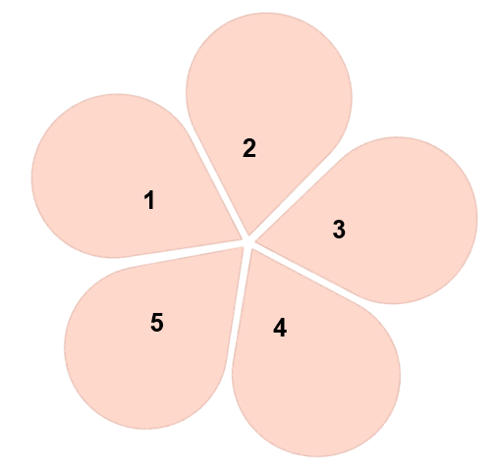
Limitation
Variable Accuracy
Model performance may vary on unseen clinical settings or different populations.
Limited X-ray Data
Hard to get high-quality labeled X-rays.
Needs Internet
Full system needs internet if used online.
Hard to Explain
Deep learning results are tough to interpret without visuals.
Not All Types
Doesn’t detect every arthritis type (e.g., psoriatic).

Slide 10
Conclusion
AI-Powered Early Diagnosis
Technological Integration
Provides an effective, AI-based tool to
support early detection and management
of arthritis.
Combines Machine Learning, Deep
Learning, and software engineering
efficiently.
Cost-Effective & Scalable
Ready for Future Clinical Use
Designed for affordable deployment in
clinics, including rural healthcare centers.
With enhancements, the system holds
strong potential for real-world medical
adoption.

Slide 11
References
[1] M.J. Lespasio, et al., Knee osteoarthritis: a primer, Perm. J. (2017) 21.
[2] A. Courties, J. Sellam, F. Berenbaum, Metabolic syndrome-associated osteoarthritis, Curr. Opin. Rheumatol. 29 (2) (2017) 214–222.
[3] F. Cabitza, A. Locoro, G. Banfi, Machine learning in orthopedics: a literature review, Frontiers Bioengin. Biotechn. (2018) 6.
[4] A.C. Staugaard, Robotics and AI: an Introduction to Applied Machine Intelligence, Prentice-Hall Englewood Cliffs, 1987.
Dataset 1 – Kaggle (https://www.kaggle.com/datasets/michaelkevin001/arthritis-clinical-dataset-using-blood-report)
Dataset 2 – Kaggle (https://www.kaggle.com/datasets/shashwatwork/knee-osteoarthritis-dataset-with-severity)

